Slide 1



Sales Analysis Report
View in Power BI
Last data refresh:
15/07/2024 20:40:25 UTC
Downloaded at:
20/07/2024 14:56:03 UTC

Slide 2
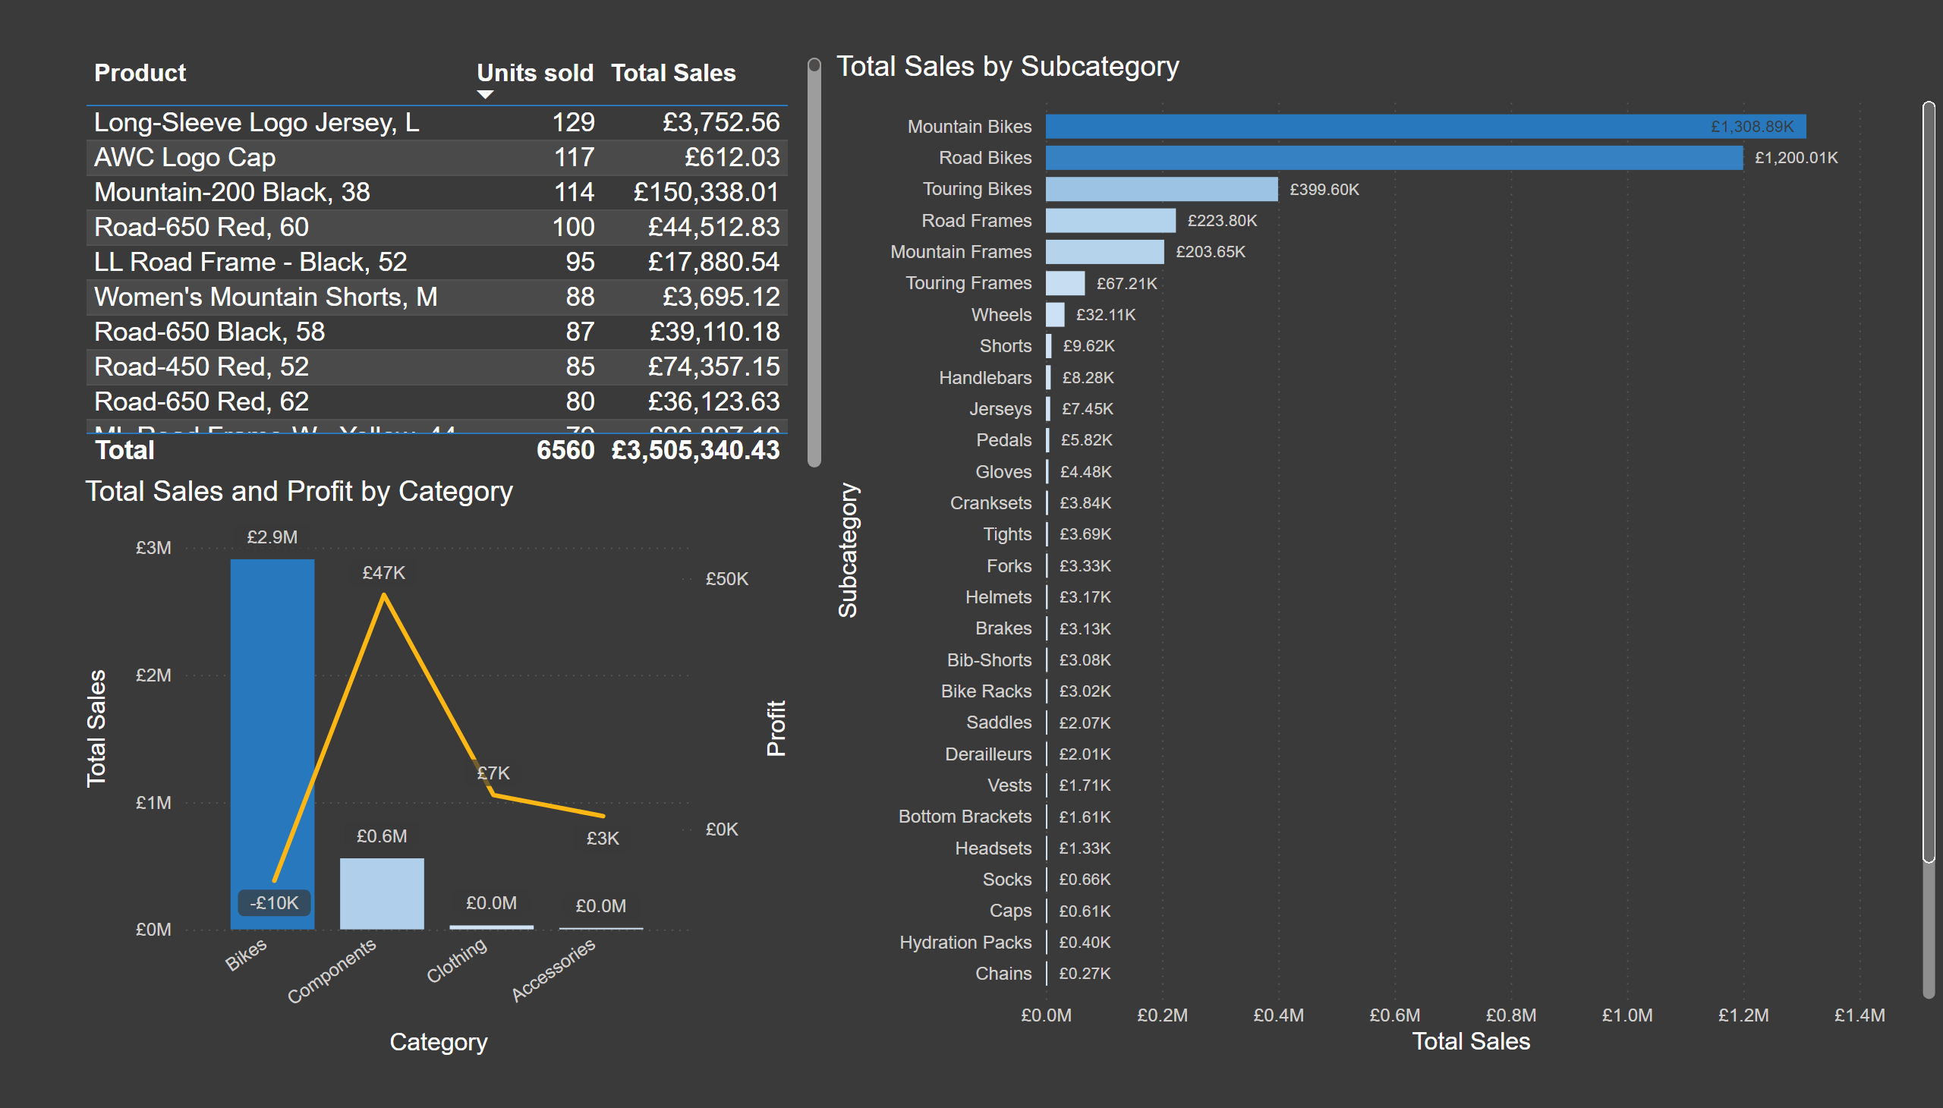
Categories
Notes:
lineStackedColumnComboChart
No alt text provided
clusteredBarChart
No alt text provided
tableEx
No alt text provided

Slide 3
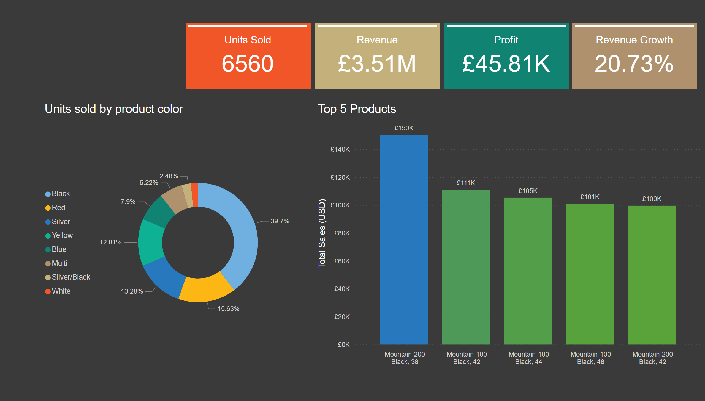
Products
Notes:
Top 5 Products
No alt text provided
cardVisual
No alt text provided
cardVisual
No alt text provided
cardVisual
No alt text provided
cardVisual
No alt text provided
Units sold by product color
No alt text provided

